Slide 2
测试内容
SISO | Cable Test |  | OTA Test
Tx (100MHz) | EVM ACLR SEM Ideal情况的测量 单个RFImp的测量 组合RFImp的测量 |  | EVM ACLR SEM Ideal情况的测量 组合RFImp的测量
Rx (100MHz) | Sensitivity | EVM Throughput Ideal情况的测量 单个RFImp的测量 组合RFImp的测量 | EVM Throughput Ideal情况的测量 组合RFImp的测量
 | Narrow Blocking
 | General Blocking
 | Intermodulation
Bandwidth=100MHz
Fc=3.5GHz

Slide 3
Phase 2 Test
Phase2测试内容：
1、对仪表参数进行测试
2、Cable测试，Ideal情况下带入仪表参数仿真并比较结果
3、OTA测试，Ideal情况下带入方向图和仪表参数仿真并比较结果

Slide 4
仪表参数测试
Cable:
Power out=0dBm
DAC_Nbits=14
GainImbalance=0.002
IQ offset=0.0044
Phase Noise =[100, -97.133, 1000, -106.072, 1e4, -118.607];
Noise Density=-133.9dBm
OTA(Tx,Sensitivity):
Power out=10dBm
DAC_Nbits=14
GainImbalance=0.002
IQ offset=0.00045
Phase Noise =[100 -98.57 1e3 -107.56 1e4 -121.67];
Noise Density=-158.7dBm
OTA_Pathloss=-54.7dBm
OTA(Blocking,Intermodulation):
Power out=15dBm
DAC_Nbits=14
GainImbalance=0.002
IQ offset=0.00002
Phase Noise =[100 -98.57 1e3 -107.56 1e4 -121.67];
Noise Density=-156.3dBm
OTA_Pathloss=-46dBm

Slide 5
Test Ideal Signal
Cable Test | Tx |  |  | Sensitivity | Narrow Blocking | General Blocking | Intermodulation
 | EVM(dB) | Upper_ ACLR(dB) | Lower_ ACLR(dB) | EVM(dB) | EVM(dB) | EVM(dB) | EVM(dB)
VXT | -48.256 | 53.746 | 53.966 | -2.407 | -8.099 | -8.05 | -8.379
Sim | -49.847 | 53.591 | 53.578 | -2.238 | -7.971 | -7.878 | -8.383
Delta

Slide 6
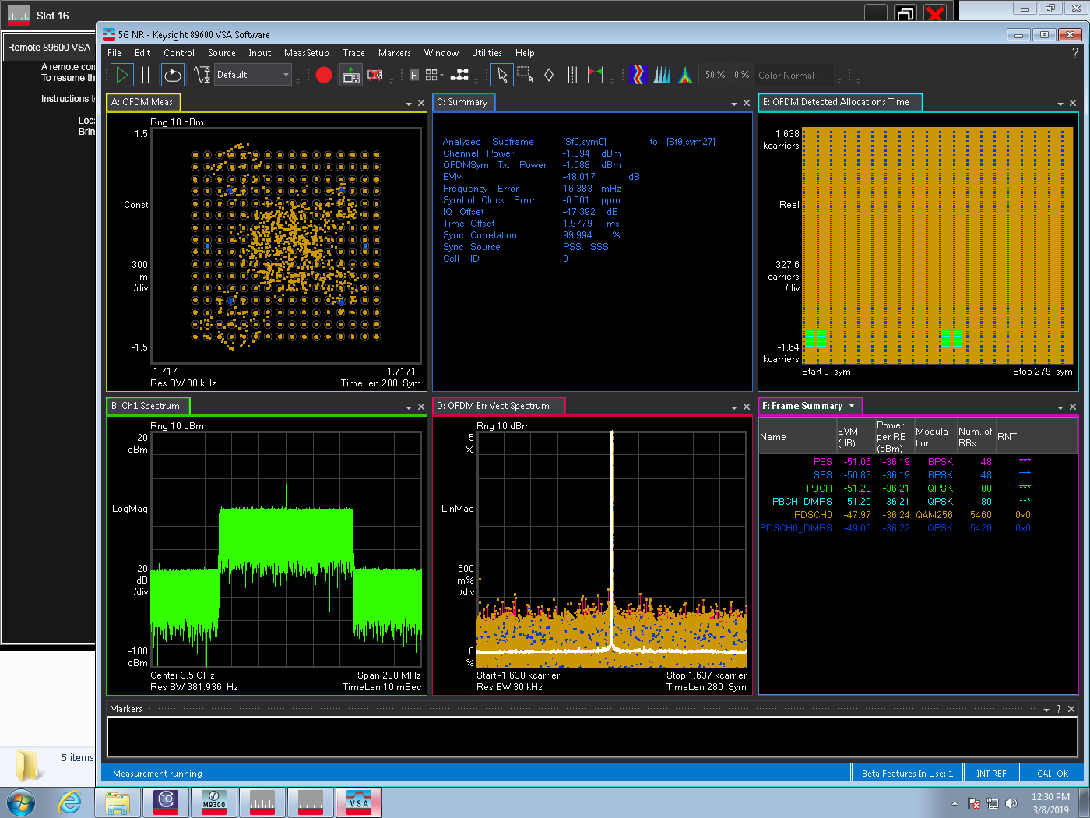
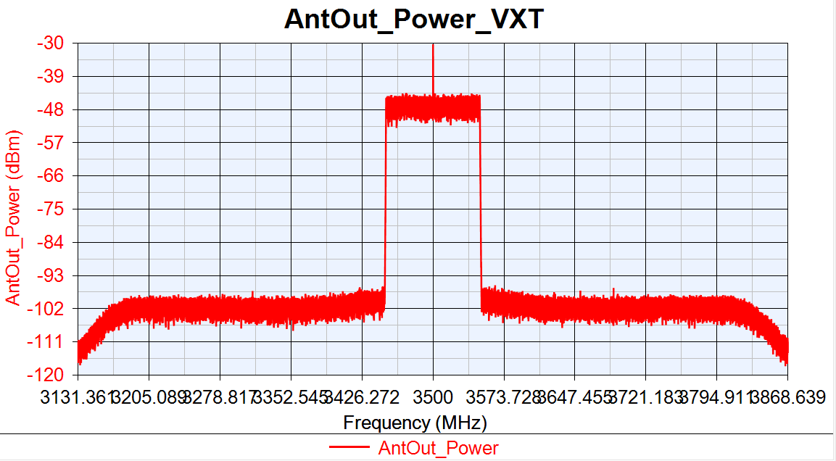
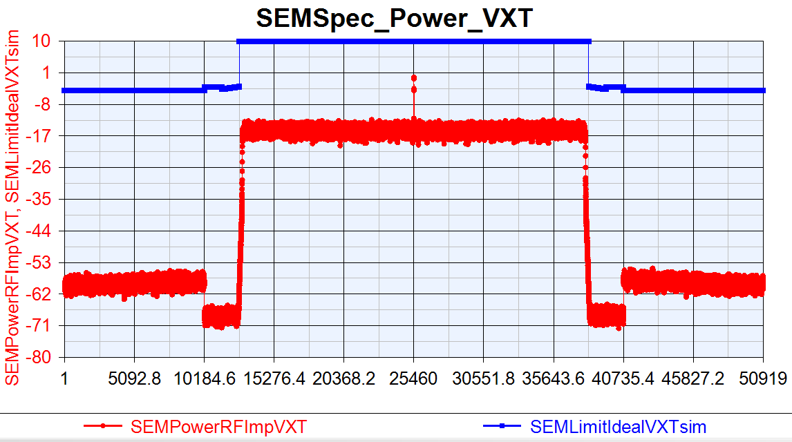
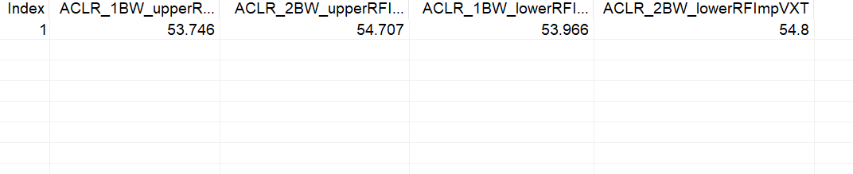
VXT Test Tx Ideal Signal
EVM:-48.256dB
IQ offset:-47.392dB

Slide 7
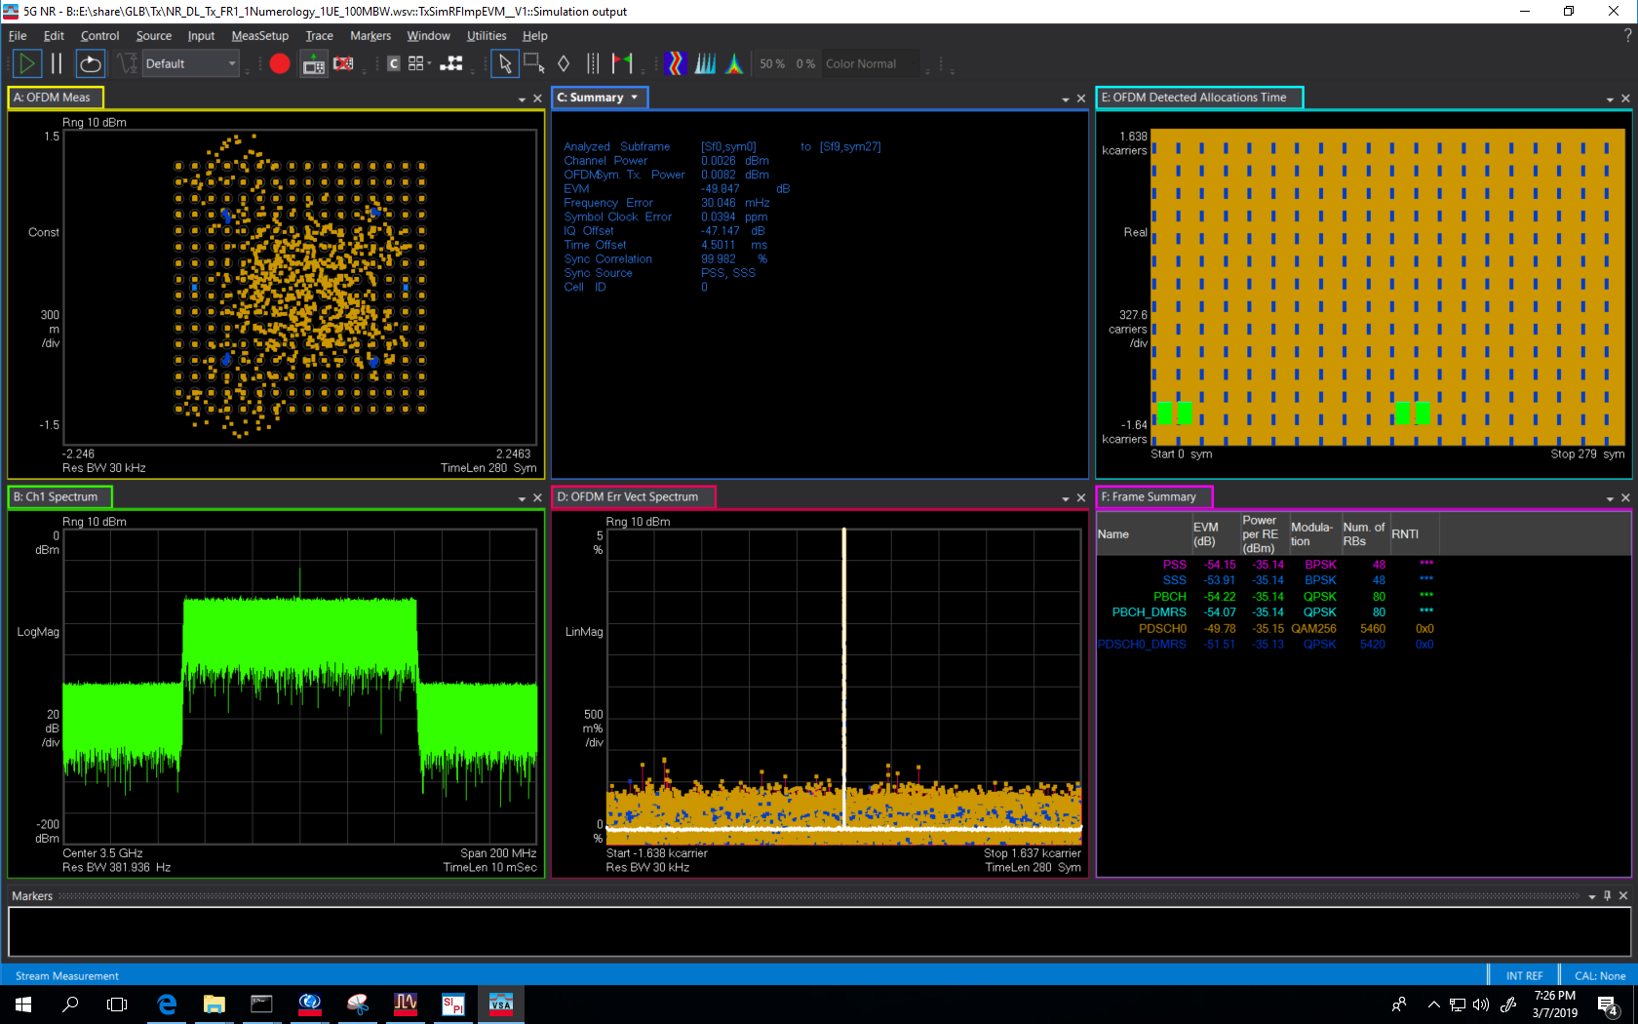
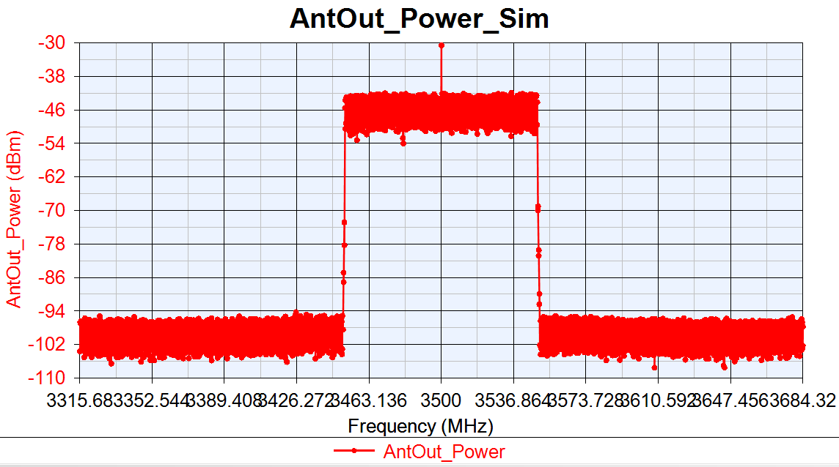

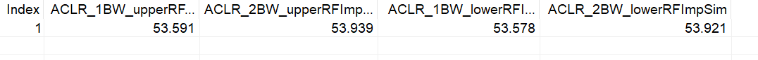
Sim Tx Ideal Signal
EVM:-49.847dB
IQoffset:-47.147dB

Slide 8
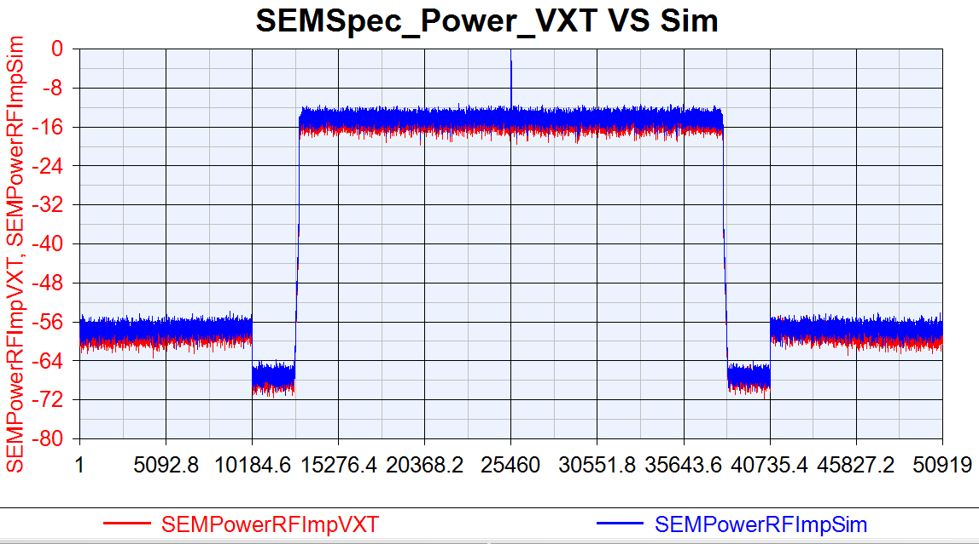
Tx Ideal Signal VXT SEM VS Sim SEM

Slide 9
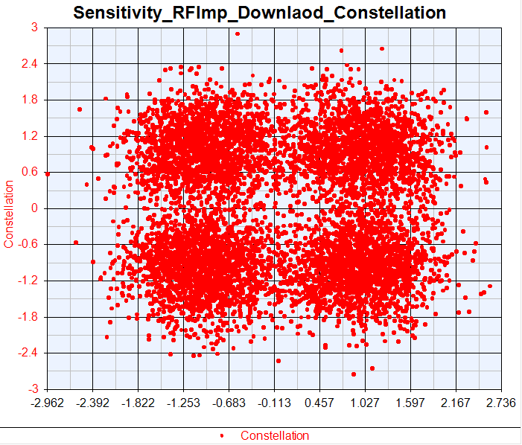
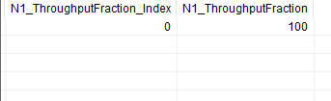
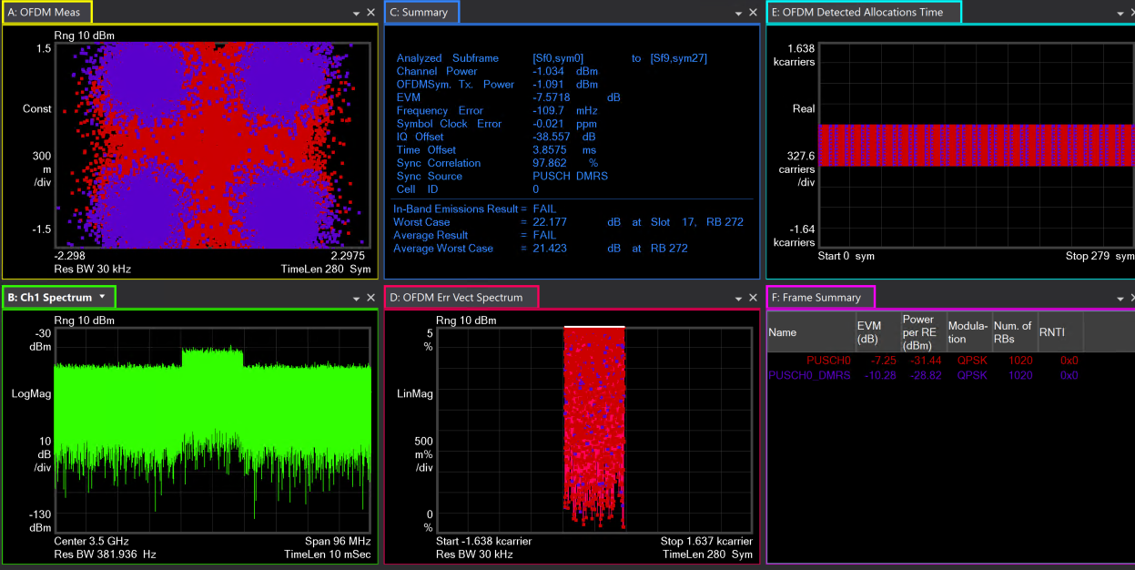
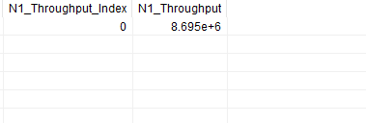
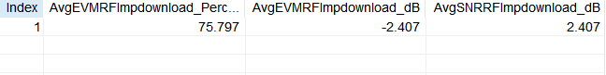
VXT Test Sensitivity Ideal Signal

Slide 10
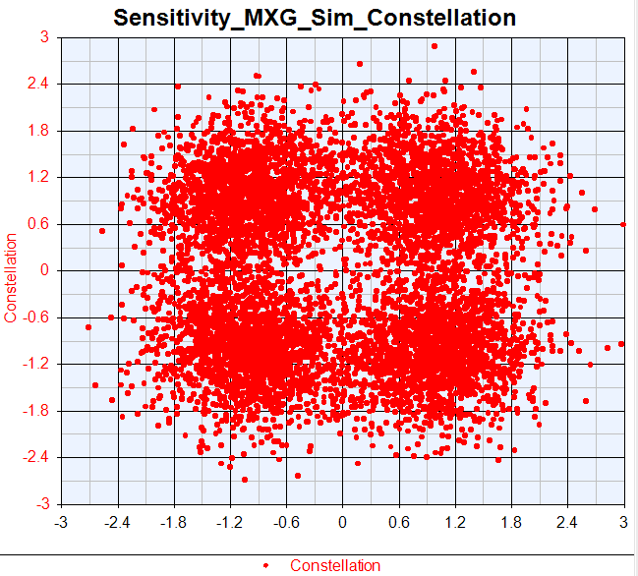
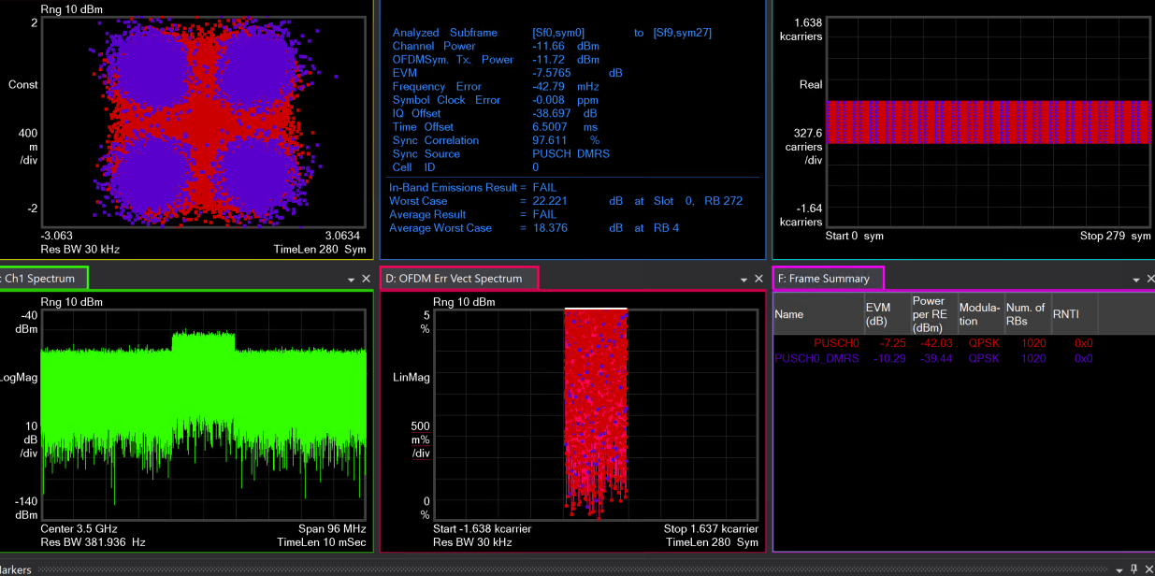
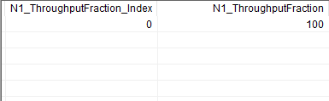
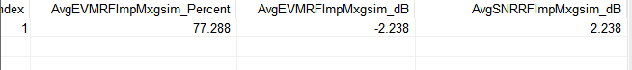
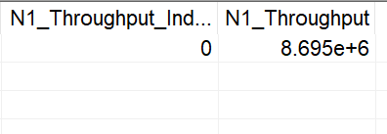
Sim Sensitivity Ideal Signal

Slide 11
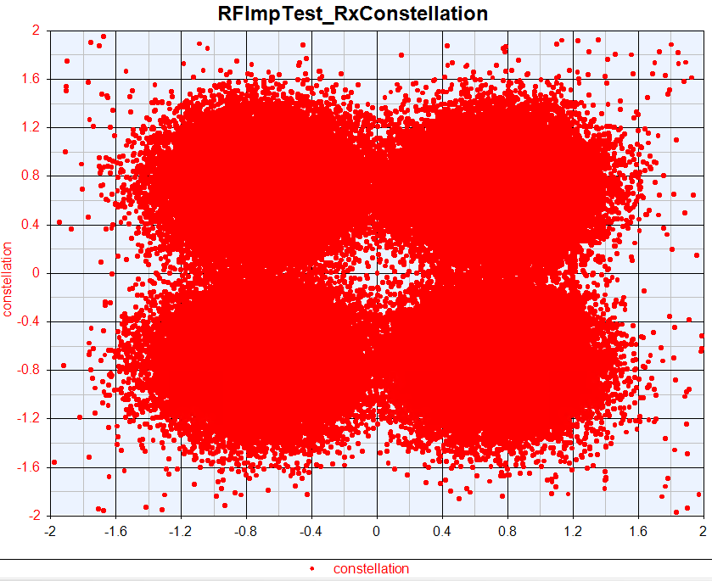
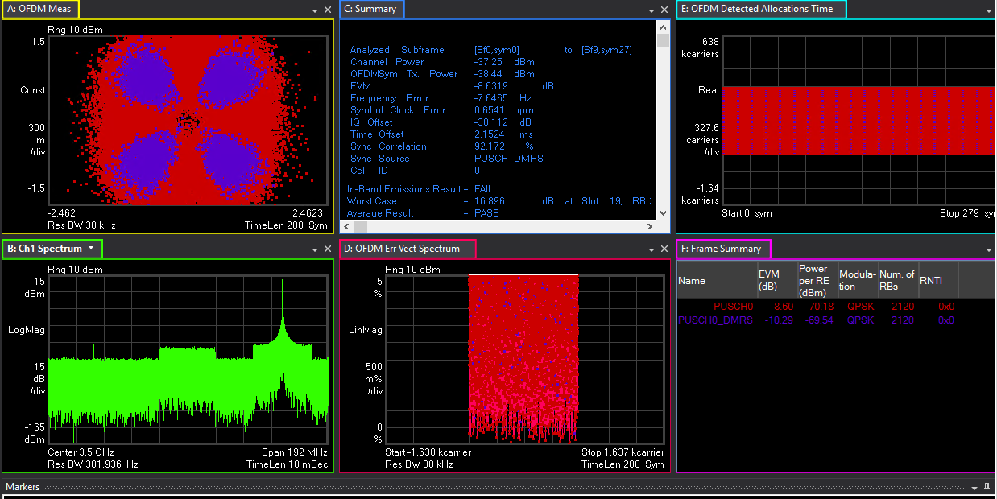
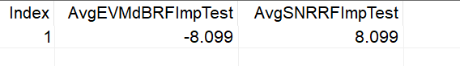
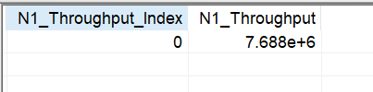
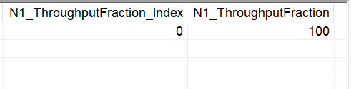
VXT Test Narrow Blocking Ideal Signal

Slide 12
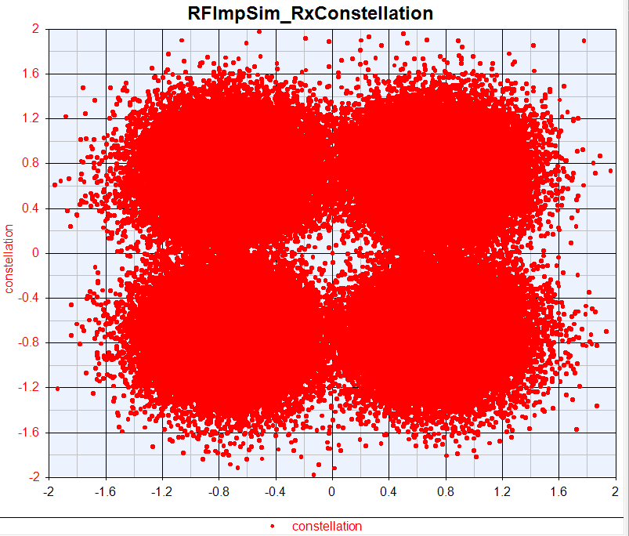
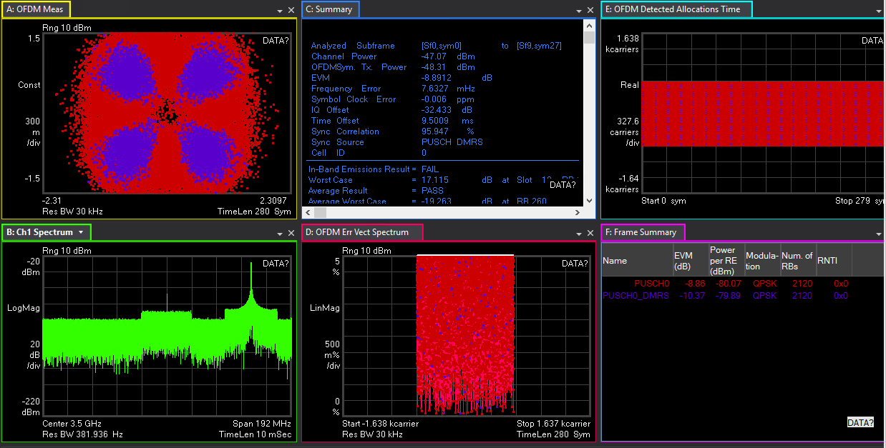
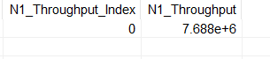
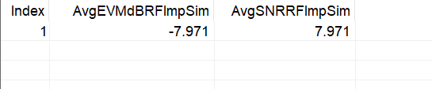
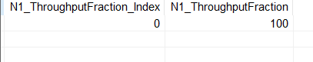
Sim Narrow Blocking Ideal Signal

Slide 13
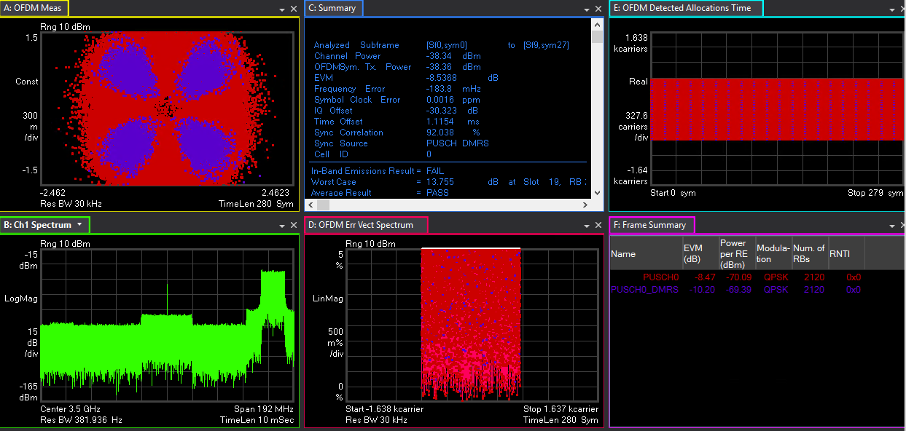
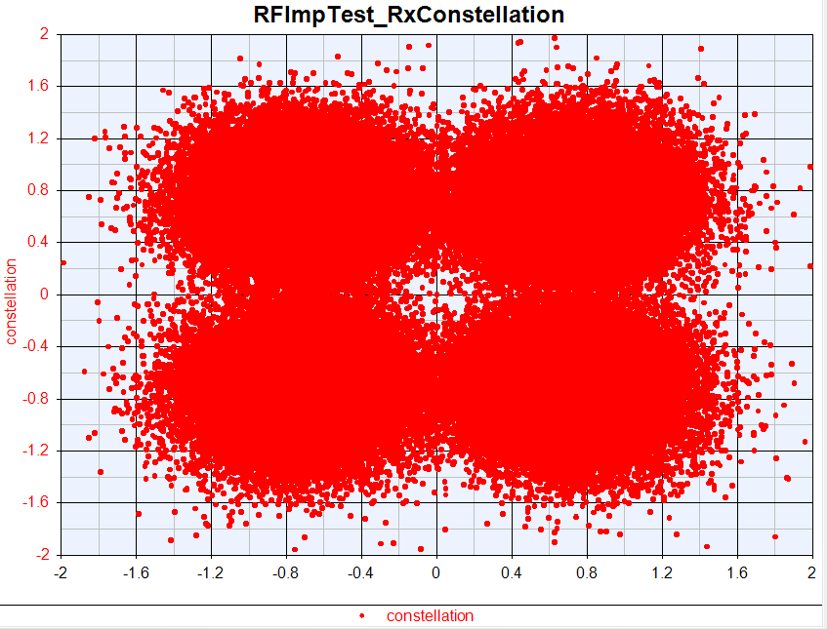
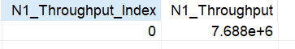
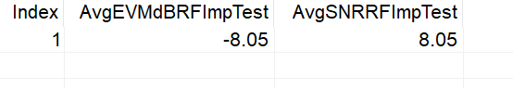
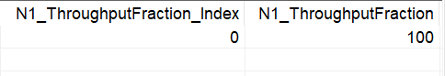
VXT Test General Blocking Ideal Signal

Slide 14
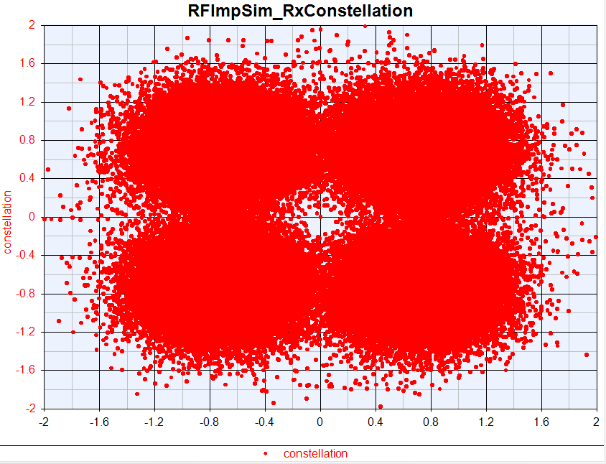

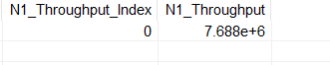
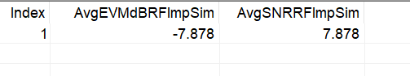
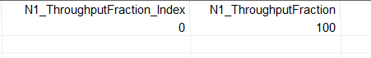
Sim General Blocking Ideal Signal

Slide 15
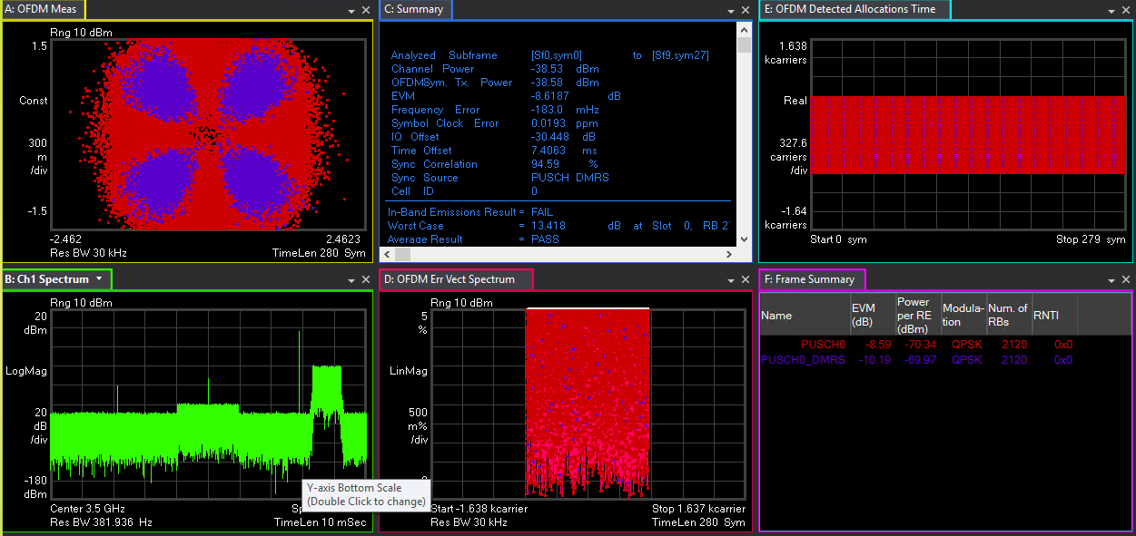
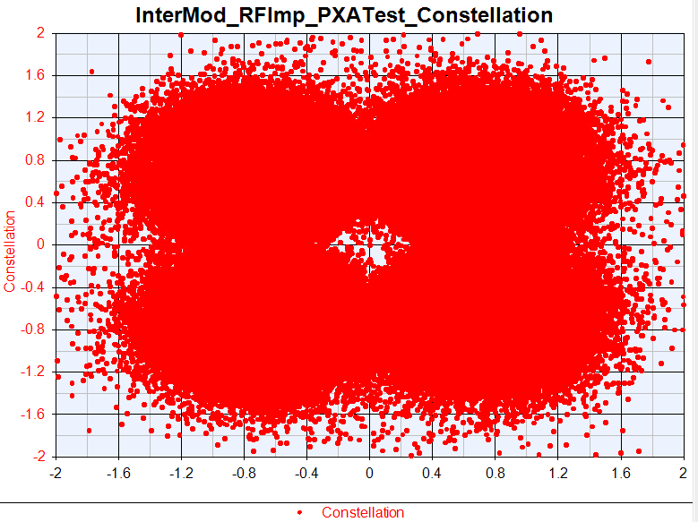
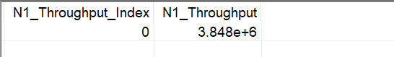
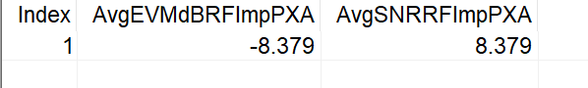
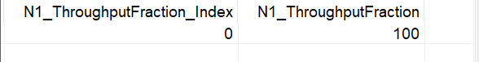
VXT Test Intermodulation Ideal Signal

Slide 16
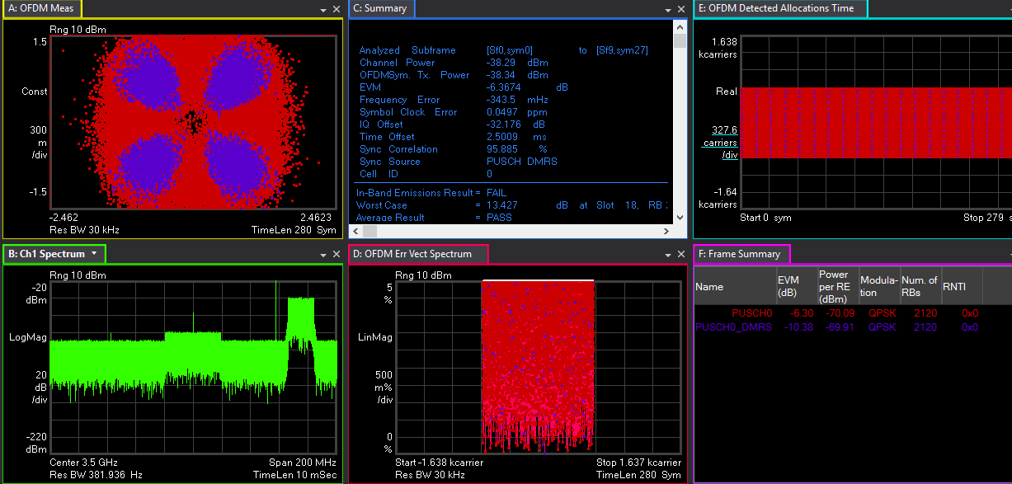
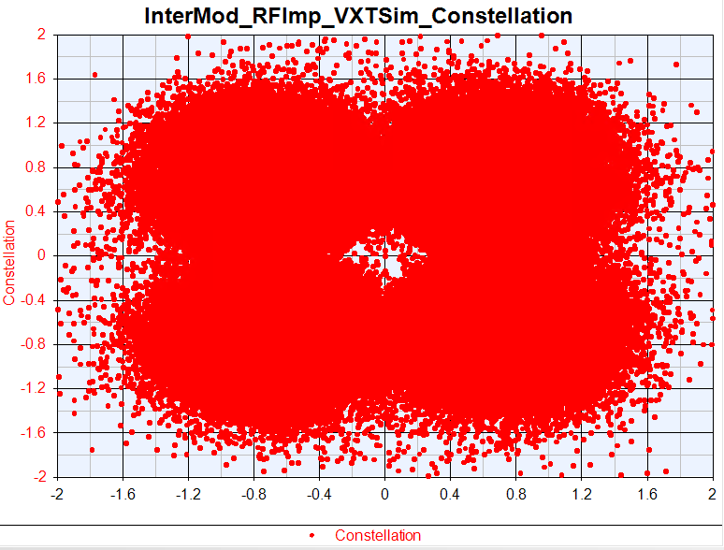
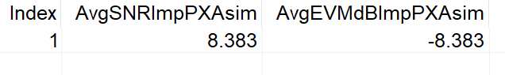
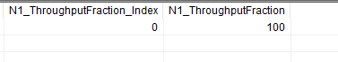
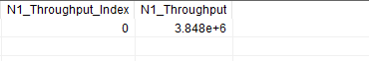
Sim Intermodulation Ideal Signal

Slide 17
OTA Test Ideal Signal
OTA Test | Tx |  |  | Sensitivity | Narrow Blocking | General Blocking | Intermodulation
 | EVM(dB) | Upper_ ACLR(dB) | Lower_ ACLR(dB) | EVM(dB) | EVM(dB) | EVM(dB) | EVM(dB)
VXT
Sim
Delta

Slide 18
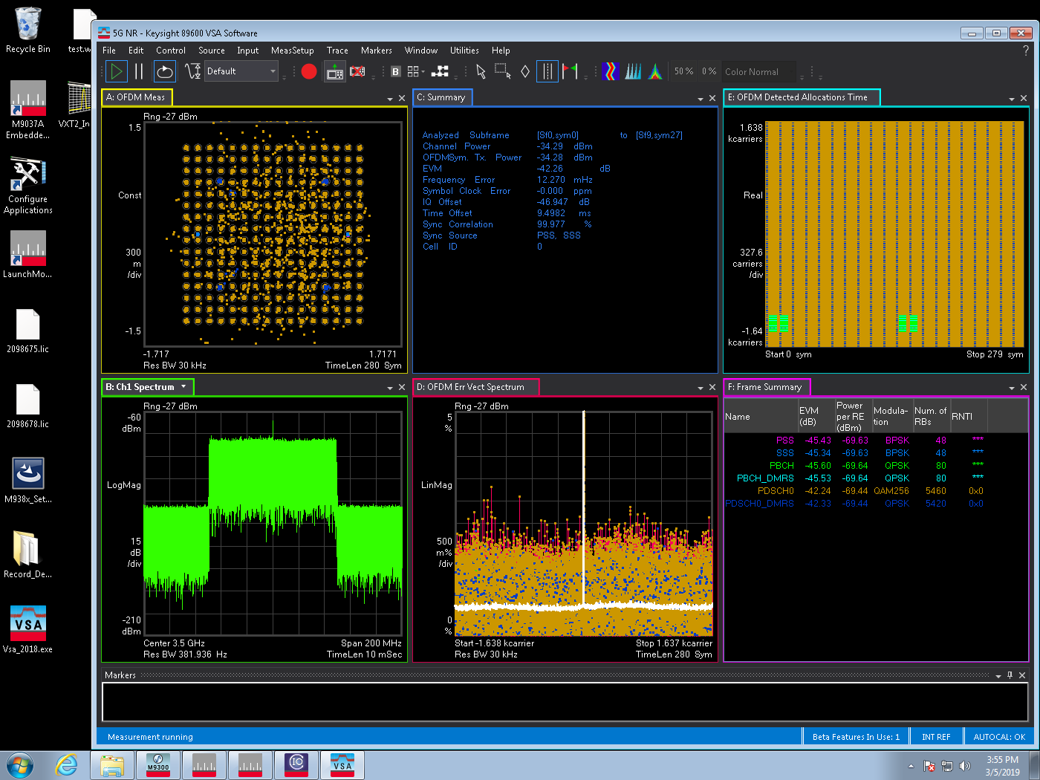
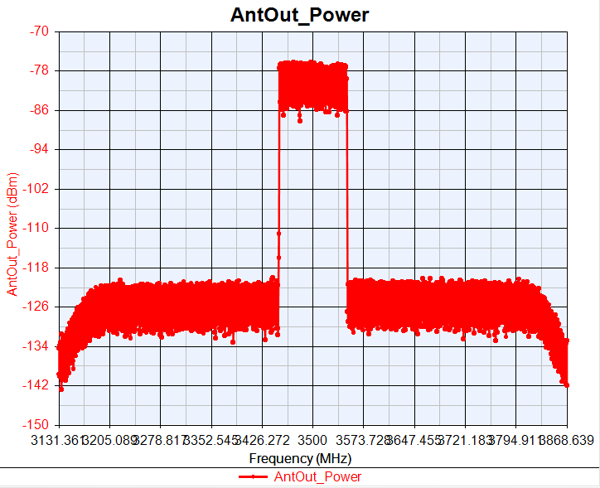
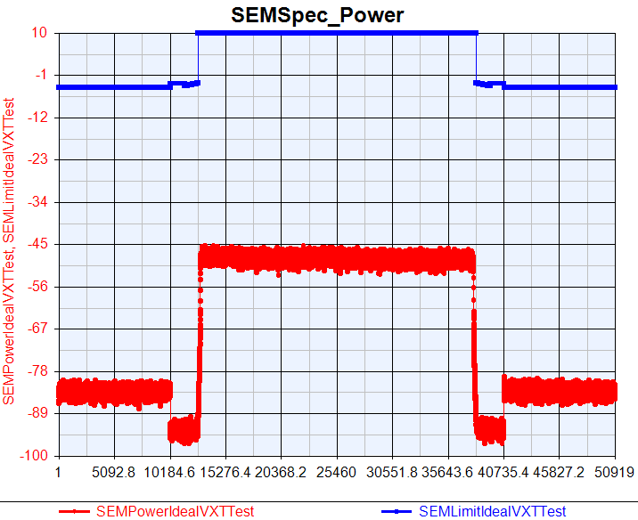

OTA VXT Test Tx Ideal Signal
EVM=-42.26
IQ offset=-46.947

Slide 19




OTA Sim Tx Ideal Signal
EVM=-42. 29
IQ offset=-47.115

Slide 20

OTA Tx Ideal Signal VXT SEM VS Sim SEM

Slide 21





OTA VXT Test Sensitivity Ideal Signal

Slide 22





OTA Sim Sensitivity Ideal Signal

Slide 23





OTA VXT Test Narrow Blocking Ideal Signal

Slide 24





OTA Sim Narrow Blocking Ideal Signal

Slide 25





OTA VXT Test General Blocking Ideal Signal

Slide 26





OTA Sim General Blocking Ideal Signal

Slide 27





OTA VXT Test Intermodulation Ideal Signal

Slide 28





OTA Sim Intermodulation Ideal Signal
Density=156.3
IQ offset=0.00002

Slide 29
Phase 3 Test
Phase 3：
过Cable带入RFImp进行测试并于仿真结果对比
过OTA带入RFImp进行测试并于仿真结果对比
具体测试内容：
Cable单点测试：在仪表参数基础上对单一因素恶化10dB，恶化15dB以及EVM有明显变化的情况
Cable组合测试：在仪表参数基础上对所有因素恶化5dB，恶化10dB
OTA 组合测试：过OTA测试Ideal的情况与加一组RFImp的情况

Slide 30
Tx Single RFImp PA Test
 | EVM(dB) |  |  | 1BW_Upper_ACLR |  |  | 1BW_Lower_ACLR
RF Imp | VXT | Sim | Delta | VXT | Sim | Delta | VXT | Sim | Delta
PA_TOI=20 | -37.54 | -37.974 | 0.434 | 43.945 | 44.369 | 0.424 | 44.108 | 44.426 | 0.318
PA_TOI=15 | -27.581 | -27.651 | 0.07 | 34.283 | 34.43 | 0.147 | 34.456 | 34.501 | 0.045

Slide 31




VXT Test Tx Single RFImp PA=15
EVM:-27.581dB
IQoffset:-47.44dB

Slide 32




Sim Tx Single RFImp PA=15
EVM:-27.651dB
IQoffset:-47.298dB

Slide 33

Tx Single RFImp PA=15 VXT SEM VS Sim SEM

Slide 34
Tx Single RFImp Phase Noise Test Compare
 | EVM(dB) |  |  | 1BW_Upper_ACLR |  |  | 1BW_Lower_ACLR
Phase Noise | VXT | Sim | Delta | VXT | Sim | Delta | VXT | Sim | Delta
-10dB | -48.27 | -49.823 | 1.553 | 53.883 | 53.565 | 0.318 | 54.132 | 53.559 | 0.573
-15dB | -48.256 | -48.869 | 0.613 | 53.869 | 53.551 | 0.318 | 54.118 | 53.568 | 0.55
-35dB | -44.057 | -44.852 | 0.795 | 54.041 | 53.543 | 0.502 | 54.316 | 53.567 | 0.749
-40dB | -32.341 | -32.389 | 0.047 | 54.069 | 53.529 | 0.48 | 54.367 | 53.581 | 0.786

Slide 35




VXT Test Tx PhaseNoise = [100, -57.133, 1000, -66.072, 1e4, -78.607]
EVM:-32.341dB
IQoffset:46.802dB

Slide 36




Sim Tx PhaseNoise = [100, -57.133, 1000, -66.072, 1e4, -78.607]
EVM:-32.359dB
IQoffset:-46.343dB

Slide 37

VXT SEM VS Sim SEM

Slide 38
DAC_Nbits Test Compare
 | EVM(dB) |  |  | 1BW_Upper_ACLR |  |  | 1BW_Lower_ACLR
DAC Nbits | VXT | Sim | Delta | VXT | Sim | Delta | VXT | Sim | Delta
14 | -48.458 | -49.843 | 1.385 | 53.743 | 53.563 | 0.18 | 53.926 | 53.579 | 0.347
12 | -48.434 | -48.813 | 0.379 | 53.773 | 53.507 | 0.224 | 54.005 | 53.502 | 0.503
10 | -48.299 | -49.204 | 0.905 | 52.503 | 52.285 | 0.218 | 52.685 | 52.281 | 0.404

Slide 39




VXT Test Tx DAC_Nbits=10
EVM:-48.299dB
IQoffset:-47.494dB

Slide 40




Sim Tx DAC_Nbits=10
EVM:-49.204dB
IQoffset:-47.121dB

Slide 41

VXT SEM VS Sim SEM

Slide 42
Tx GainImbalance Test Compare
 | EVM(dB) |  |  | 1BW_Upper_ACLR |  |  | 1BW_Lower_ACLR
Gain Imbalance | VXT | Sim | Delta | VXT | Sim | Delta | VXT | Sim | Delta
0.02 | -48.323 | -49.2 | 0.877 | 53.876 | 53.584 | 0.292 | 54.134 | 53.575 | 0.559
0.03 | -47.5 | -48.261 | 0.761 | 53.898 | 53.561 | 0.337 | 54.106 | 53.593 | 0.513
0.1 | -42.374 | -43.165 | 0.791 | 54.046 | 53.591 | 0.455 | 54.305 | 53.588 | 0.717
0.3 | -34.544 | -34.746 | 0.202 | 54.071 | 53.569 | 0.502 | 54.308 | 53.59 | 0.718

Slide 43




VXT Test Tx GainImbalance=0.3
EVM:-34.544dB
IQoffset:-47.223dB

Slide 44




Sim Tx GainImbalance=0.3
EVM:-34.746dB
IQoffset:-47.117dB

Slide 45

VXT SEM VS Sim SEM

Slide 46
Tx IQoffset Test Compare
 | EVM(dB) |  |  | 1BW_Upper_ACLR |  |  | 1BW_Lower_ACLR
IQ offset | VXT | Sim | Delta | VXT | Sim | Delta | VXT | Sim | Delta
0.014 | -48.308 | -49.806 | 1.498 | 53.839 | 53.603 | 0.236 | 54.134 | 53.586 | 0.548
0.025 | -48.302 | -49.553 | 1.251 | 53.852 | 53.602 | 0.25 | 54.143 | 53.607 | 0.536
0.2 | -41.065 | -42.133 | 1.068 | 54.045 | 53.421 | 0.624 | 54.269 | 53.449 | 0.82
0.4 | -32.981 | -33.456 | 0.475 | 54.07 | 53.377 | 0.693 | 54.284 | 53.388 | 0.896

Slide 47




VXT Test Tx IQoffset=0.4
EVM:-32.981dB
IQoffset:-42.814dB

Slide 48




Tx Single RFImp Sim IQoffset=0.4
EVM:-33.456dB
IQoffset:-42.827dB

Slide 49

VXT SEM VS Sim SEM

Slide 50
Tx Combine RFImp Test Compare
 | EVM(dB) |  |  | 1BW_Upper_ACLR |  |  | 1BW_Lower_ACLR
Combine Test | VXT | Sim | Delta | VXT | Sim | Delta | VXT | Sim | Delta
Origin Para | -48.256 | -49.847 | 1.591 | 53.746 | 53.591 | 0.155 | 53.966 | 53.578 | 0.388
Change 5dB | -45.294 | -46.33 | 1.036 | 50.969 | 51.347 | 0.378 | 51.21 | 51.369 | 0.159
Change 10dB | -37.388 | -37.69 | 0.302 | 43.794 | 44.096 | 0.312 | 43.969 | 44.182 | 0.213

Slide 51




Tx VXT Combine RFImp Change 10dB Test
EVM:-37.388dB
IQoffset:-40.8dB

Slide 52




Tx Combine RFImp Change 10dB Sim
EVM:-37.69dB
IQoffset:-41.316dB

Slide 53

VXT SEM VS Sim SEM

Slide 54
Sensitivity VXT Single RFImp Noise Figure Test
Noise Figure | VXT_EVM (%) | Sim_EVM (%) | Delta (%) | VXT_SNR (dB) | Sim_SNR (dB) | Delta (dB) | VXT_ Throughput (%) | Sim_ Throughput (%)
0 | 75.797 | 77.288 | 1.491 | 2.407 | 2.238 | 0.169 | 100 | 100
5 | 123.972 | 125.789 | 1.817 | -1.866 | -1.993 | 0.127 | 100 | 100
7 | 185.612 | 167.28 | 18.332 | -5.372 | -4.469 | 0.903 | 68 | 90
10 | 323.36 | 333.448 | 10.088 | -10.194 | -10.461 | 0.267 | 0 | 0

Slide 55





Sensitivity VXT Single RFImp Test Noise Figure=7

Slide 56





Sim Noise Figure=7

Slide 57
PhaseNoise Test
PhaseNoise | VXT_EVM (%) | Sim_EVM (%) | Delta (%) | VXT_SNR (dB) | Sim_SNR (dB) | Delta (dB) | VXT_ Throughput (%) | Sim_ Throughput (%)
Change 10dB | 76.216 | 78.395 | 2.179 | 2.359 | 2.114 | 0.245 | 100 | 100
Change 15dB | 78.29 | 78.628 | 0.338 | 2.126 | 2.088 | 0.038 | 100 | 100
Change 65dB | 150.145 | 139.692 | 10.453 | -3.53 | -2.903 | 0.627 | 64 | 60

Slide 58





VXT PhaseNoise=[100, -32.133, 1000, -41.072, 1e4, -53.607]

Slide 59





Sim PhaseNoise=[100, -32.133, 1000, -41.072, 1e4, -53.607]

Slide 60
Gain Imbalance Test
Gain Imbalance | VXT_EVM (%) | Sim_EVM (%) | Delta (%) | VXT_SNR (dB) | Sim_SNR (dB) | Delta (dB) | VXT_ Throughput (%) | Sim_ Throughput (%)
0.02 | 77.61 | 79.184 | 1.574 | 2.202 | 2.027 | 0.175 | 100 | 100
0.03 | 80.095 | 82.13 | 2.035 | 1.928 | 1.71 | 0.218 | 100 | 100
20 | 151.952 | 152.79 | 0.838 | -3.634 | -3.682 | 0.048 | 88 | 70

Slide 61





VXT GainImbalance=20

Slide 62





Sim GainImbalance=20

Slide 63
IQ offset Test
IQ offset | VXT_EVM (%) | Sim_EVM (%) | Delta (%) | VXT_SNR (dB) | Sim_SNR (dB) | Delta (dB) | VXT_ Throughput (%) | Sim_ Throughput (%)
0.014 | 78.095 | 78.846 | 0.751 | 2.148 | 2.064 | 0.084 | 100 | 100
0.025 | 84.547 | 84.778 | 0.231 | 1.458 | 1.434 | 0.024 | 100 | 100
1.2 | 624.005 | 655.333 | 31.328 | -15.904 | -16.328 | 0.424 | 58 | 50

Slide 64





VXT IQ offset=1.2

Slide 65





Sim IQ offset=1.2

Slide 66
ADC_Nbits Test
ADC_ Nbits | VXT_EVM (%) | Sim_EVM (%) | Delta (%) | VXT_SNR (dB) | Sim_SNR (dB) | Delta (dB) | VXT_ Throughput (%) | Sim_ Throughput (%)
14 | 75.797 | 77.288 | 1.491 | 2.407 | 2.238 | 0.169 | 100 | 100
12 | 78.357 | 80.035 | 1.678 | 2.118 | 1.934 | 0.184 | 100 | 100
10 | 79.693 | 81.703 | 2.01 | 1.972 | 1.755 | 0.217 | 100 | 100

Slide 67





VXT ADC _Nbits=10

Slide 68





Sim ADC _Nbits=10

Slide 69
Combine Test
Combine Test | VXT_EVM (%) | Sim_EVM (%) | Delta (%) | VXT_SNR (dB) | Sim_SNR (dB) | Delta (dB) | VXT_ Throughput (%) | Sim_ Throughput (%)
Origin | 75.797 | 77.288 | 1.491 | 2.407 | 2.238 | 0.169 | 100 | 100
Change 5dB | 134.103 | 135.736 | 1.633 | -2.549 | -2.654 | 0.105 | 100 | 100
Change 10dB | 186.985 | 209.631 | 22.646 | -5.436 | -6.429 | 0.993 | 74 | 50

Slide 70





VXT Combine Test (Change 5dB)

Slide 71





Sim Combine Test (Change 5dB)

Slide 72





VXT Combine Test (Change 10dB)

Slide 73





Sim Combine Test (Change 10dB)

Slide 74





VXT Noise Figure=13

Slide 75





Sim Noise Figure=13

Slide 76
Phase Noise Test
Phase Noise | VXT_EVM | Sim_EVM | Delta | VXT_Throughput | Sim_Throghput
-10dB | -7.385 | -7.449 | 0.064 | 100 | 100
-15dB | -7.191 | -7.17 | 0.021 | 100 | 100
-70dB | 3.916 | 4.182 | 0.266 | 30 | 25

Slide 77





VXT Phase Noise =[100, -27.133, 1000, -36.072, 1e4, -48.607]

Slide 78





Sim Phase Noise =[100, -27.133, 1000, -36.072, 1e4, -48.607]

Slide 79
GainImbalance Test
Gain Imbalance | VXT_EVM | Sim_EVM | Delta | VXT_Throughput | Sim_Throghput
0.02 | -7.81 | -7.802 | 0.008 | 100 | 100
0.03 | -7.637 | -7.545 | 0.092 | 100 | 100
16 | -0.576 | -0.65 | 0.074 | 55 | 65

Slide 80





VXT GainImbalance=16

Slide 81





Sim GainImbalance=16

Slide 82
IQ offset Test
IQ offset | VXT_EVM | Sim_EVM | Delta | VXT_Throughput | Sim_Throghput
0.0014 | -6.817 | -6.222 | 0.595 | 100 | 100
0.0045 | -3.336 | -3.321 | 0.015 | 100 | 100
0.05 | 24.488 | 24.066 | 0.422 | 5 | 5

Slide 83





VXT IQ offset =0.05

Slide 84





Sim IQ offset=0.05

Slide 85
ADC_Nbits Test
ADC_Nbits | VXT_EVM | Sim_EVM | Delta | VXT_Throughput | Sim_Throghput
14 | -8.099 | -7.971 | 0.128 | 100 | 100
12 | -7.891 | -7.912 | 0.021 | 100 | 100
10 | -7.652 | -7.698 | 0.046 | 100 | 100

Slide 86





VXT ADC_Nbits=10

Slide 87





Sim ADC_Nbits=10

Slide 88
Combine Test
Combine Test | VXT_EVM | Sim_EVM | Delta | VXT_Throughput | Sim_Throghput
Origin Para | -8.099 | -7.971 | 0.128 | 100 | 100
Change 5dB | -3.001 | -2.986 | 0.015 | 100 | 100
Change 10dB | 2.924 | 3.073 | 0.149 | 100 | 100

Slide 89





VXT Combine Test Change 10dB

Slide 90





Sim Combine Test Change 10dB

Slide 91
Noise Figure Test
Noise Figure | VXT_EVM | Sim_EVM | Delta | VXT_Throughput | Sim_Throghput
0 | -8.05 | -7.878 | 0.172 | 100 | 100
5 | -2.865 | -2.712 | 0.153 | 100 | 100
10 | 2.366 | 2.19 | 0.176 | 100 | 100
13 | 6.304 | 6.249 | 0.055 | 90 | 35

Slide 92




VXT Noise Figure=13

Slide 93




Sim Noise Figure=13

Slide 94
Phase Noise Test
Phase Noise | VXT_EVM | Sim_EVM | Delta | VXT_Throughput | Sim_Throghput
-10dB | -7.748 | -7.723 | 0.025 | 100 | 100
-15dB | -7.605 | -7.532 | 0.073 | 100 | 100
-65dB | -3.846 | -4.051 | 0.205 | 75 | 70

Slide 95





VXT Phase Noise =[100, -32.133, 1000, -41.072, 1e4, -53.607]

Slide 96





Sim Phase Noise =[100, -32.133, 1000, -41.072, 1e4, -53.607]

Slide 97
GainImbalance Test
Gain Imbalance | VXT_EVM | Sim_EVM | Delta | VXT_Throughput | Sim_Throghput
0.02 | -7.822 | -7.588 | 0.234 | 100 | 100
0.03 | -7.785 | -7.573 | 0.212 | 100 | 100
8 | 11.205 | 11.675 | 0.47 | 95 | 75

Slide 98





VXT GainImbalance=8

Slide 99





Sim GainImbalance=8

Slide 100
IQ offset Test
IQ offset | VXT_EVM | Sim_EVM | Delta | VXT_Throughput | Sim_Throghput
0.0014 | -6.819 | -6.32 | 0.499 | 100 | 100
0.0045 | -3.602 | -3.485 | 0.117 | 100 | 100
0.04 | 1.762 | 1.721 | 0.041 | 25 | 25

Slide 101





VXT IQ offset =0.04

Slide 102





Sim IQ offset=0.04

Slide 103
ADC_Nbits Test
ADC_Nbits | VXT_EVM | Sim_EVM | Delta | VXT_Throughput | Sim_Throghput
14 | -8.05 | -7.878 | 0.172 | 100 | 100
12 | -7.91 | -7.886 | 0.024 | 100 | 100
10 | -7.729 | -7.621 | 0.108 | 100 | 100

Slide 104





VXT ADC_Nbits=10

Slide 105





Sim ADC_Nbits=10

Slide 106
Combine Test
Combine Test | VXT_EVM | Sim_EVM | Delta | VXT_Throughput | Sim_Throghput
Origin Para | -8.05 | -7.878 | 0.172 | 100 | 100
Change 5dB | -3.022 | -2.841 | 0.181 | 100 | 100
Change 10dB | 2.433 | 2.327 | 0.106 | 100 | 100

Slide 107





VXT Combine Test Change 5dB

Slide 108





Sim Combine Test Change 5dB

Slide 109





VXT Combine Test Change 10dB

Slide 110





Sim Combine Test Change 10dB

Slide 111
Noise Figure Test
Noise Figure | VXT_EVM | Sim_EVM | Delta | VXT_Throughput | Sim_Throghput
0 | -8.379 | -8.383 | 0.004 | 100 | 100
5 | -3.32 | -3.551 | 0.231 | 100 | 100
10 | 1.853 | 1.816 | 0.037 | 100 | 100
13 | 6.401 | 6.254 | 0.147 | 15 | 30

Slide 112




VXT Noise Figure=13

Slide 113




Sim Noise Figure=13

Slide 114
Phase Noise Test
Phase Noise | VXT_EVM | Sim_EVM | Delta | VXT_Throughput | Sim_Throghput
-10dB | -8.293 | -8.288 | 0.005 | 100 | 100
-15dB | -8.195 | -8.189 | 0.006 | 100 | 100
-65dB | -0.533 | -0.541 | 0.008 | 65 | 65

Slide 115





VXT Phase Noise =[100, -32.133, 1000, -41.072, 1e4, -53.607]

Slide 116





Sim Phase Noise =[100, -32.133, 1000, -41.072, 1e4, -53.607]

Slide 117
GainImbalance Test
Gain Imbalance | VXT_EVM | Sim_EVM | Delta | VXT_Throughput | Sim_Throghput
0.02 | -8.061 | -8.103 | 0.042 | 100 | 100
0.03 | -7.992 | -8.032 | 0.04 | 100 | 100
16 | -1.885 | -1.758 | 0.127 | 60 | 65

Slide 118





VXT GainImbalance=16

Slide 119





Sim GainImbalance=16

Slide 120
IQ offset Test
IQ offset | VXT_EVM | Sim_EVM | Delta | VXT_Throughput | Sim_Throghput
0.002 | -5.935 | -5.342 | 0.593 | 100 | 100
0.0035 | -4.496 | -3.56 | 0.936 | 100 | 100
0.03 | 25.316 | 25.341 | 0.025 | 60 | 60

Slide 121




VXT IQ offset =0.03

Slide 122




Sim IQ offset=0.03

Slide 123
ADC_Nbits Test
ADC_Nbits | VXT_EVM | Sim_EVM | Delta | VXT_Throughput | Sim_Throghput
14 | -8.379 | -8.383 | 0.004 | 100 | 100
12 | -8.084 | -8.046 | 0.038 | 100 | 100
10 | -7.555 | -7.757 | 0.202 | 100 | 100

Slide 124





VXT ADC_Nbits=10

Slide 125





Sim ADC_Nbits=10

Slide 126
Combine Test
Combine Test | VXT_EVM | Sim_EVM | Delta | VXT_Throughput | Sim_Throghput
Origin Para | -8.379 | -8.383 | 0.004 | 100 | 100
Change 5dB | -3.104 | -2.9 | 0.204 | 100 | 100
Change 10dB | 1.972 | 2.402 | 0.43 | 100 | 100

Slide 127





VXT Combine Test Change 5dB

Slide 128





Sim Combine Test Change 5dB

Slide 129





VXT Combine Test Change 10dB

Slide 130





Sim Combine Test Change 10dB

Slide 131
OTA Test Para

Slide 132
OTA Test Result

Slide 133




Test OTA Tx RFImp
EVM=-34.409
IQ offset=-35.376

Slide 134




Sim OTA Tx RFImp
EVM=-34.924
IQ offset=-35.443

Slide 135

VXT SEM VS Sim SEM

Slide 136





Test OTA Sensitivity RFImp

Slide 137





Sim OTA Sensitivity RFImp

Slide 138





Test OTA RFImp Narrow Blocking

Slide 139





Sim OTA RFImp Narrow Blocking

Slide 140





Test OTA RFImp General Blocking

Slide 141





Sim OTA RFImp General Blocking

Slide 142





OTA RFImp Intermodulation Test

Slide 143





Sim OTA RFImp Intermodulation

